Slide 1
Unit 5
Moles, Mole Conversions, Percent Composition, Empirical/Molecular Formulas

Slide 2
So….
Please make sure you focus during this unit!
It can be intimidating, but it doesn’t have to be
But, it will require your concentration and engagement, just how this course has proceeded thus far
While I cannot say the same about atomic theory, understanding the mole and how to make conversions with it is one of the applicable skills in chemistry!
I used this a ton and for you college bound kids, it will come up again in your sciences!

Slide 3
The Mole is Applied to Several Different Aspects of Chemistry
Solution preparation
Stoichiometry
Gas Law
Basically anything that involves calculations in chemistry because it allows us to count particles, atoms, and molecules by weighing them.
Practically everything in chem! Especially that which is analytical in nature

Slide 4
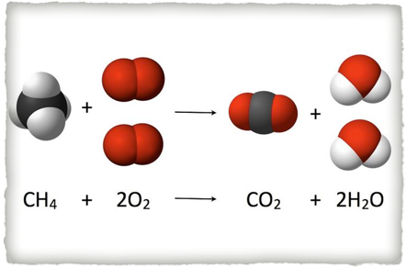
A Balanced Equation Should Now Be Interpreted as Such
1 mole of methane and 2 moles of oxygen yield 1 mole of carbon dioxide and 2 moles of water

Slide 5
Topics in this Unit
SI Unit for Amount of Substance: The Mole
Identifying Avogadro’s # and why it’s important
Mole Conversions
Multistep Conversions
Percent composition calculations
Empirical/Molecular Formula Calculations

Slide 6
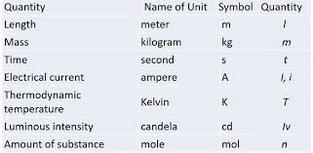
Review
SI Units

Slide 7
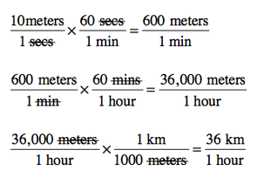
Factor Label/Dimensional Analysis

Slide 8
The Mole
No it is not a special freckle, or a rodent
The mole is unit of measurement that is used specifically to measure the number of atoms/molecules in substance by weighing it!
1 mole = 6.02 * 10^23 of anything just as….
1 dozen = 12 of anything

Slide 9
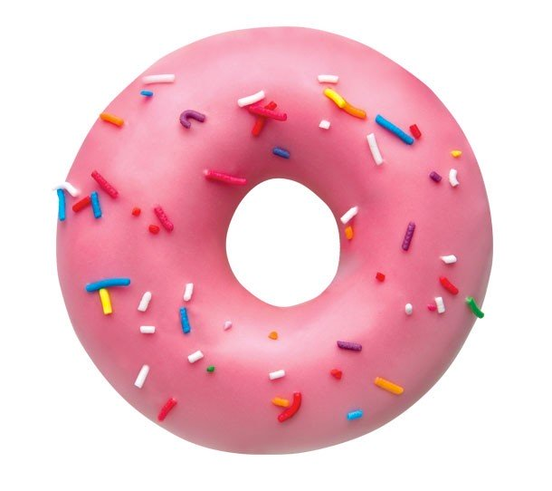
Our Donut Analogy
We are going to pretend that a one Homer’s donuts weighs exactly 1.0 grams
Then we can assume that a dozen of Homer’s donut weighs exactly 12.0 grams

Slide 10
A Good Analogy
Mass
Counting principle
Count
12.0 grams
1 dozen
12 donuts

Slide 11
Conversion Practice
Convert 8 dozen to donuts
Convert 20 donuts to dozens
Convert 15 dozens to donuts

Slide 12
Conversion Practice
Convert 25.0 grams of donuts to dozens
Convert 144.0 grams of donuts to dozens
Convert 50.0 grams of donuts to dozens

Slide 13
Conversion Practice
Convert 150 donuts to grams
Convert 11 donuts to grams
Convert 140.15 grams of donuts to dozens

Slide 14
The Mole
Why is the mole necessary?
Remember back to atomic theory, that atoms and molecules are unfathomably small
There are more atoms in a mole of water than there are stars in the universe
We need a gigantic number in order for us to be able to work with known amounts of substances that we can actually see!!
In this way we can use grams and balances to measure substances and predict reactions

Slide 15
The Mole
Once again…
It’s simply a counting principal just like a dozen
A dozen doesn’t have a units, it’s simply a quantity in which can be used to describe the amount of something
You can have a dozen tires or a dozen bicycles
Notice in this example that if you have a dozen bicycles, you have 2 dozen
What is important here is that you can have a dozen tires, but a dozen bikes has a 2 dozen tires

Slide 16
Avogadro’s number
6.02 * 10^23 of “something”
In chemistry (really its only usage) it is used to describe the amount of atoms or molecules in 1 MOLE of a substance

Slide 17
Where does this number come from?
Well…
It was first theorized but has been scientifically proven by dividing a mole of electrons by an individual charge of an election which proved Avogadro’s number

Slide 18
How does this relate to the periodic table?
Avogrado’s number corresponds the number of atoms in 12.0 grams of carbon 12! (1 mole)
Notice now, that carbons average atomic mass is 12.0
Therefore….
An atoms average atomic mass can be interpreted as its mass per 1 mole of substance
This is called molar mass

Slide 19
Useful Vocabulary
Mole - SI Unit for Amount of Substance
Avogadro’s number - 6.02 * 10 ^ 23
Molar mass - mass per 1 mole of substance (also referred to as molecular mass or formula weight if we are dealing with compounds)
MW - molecular weight

Slide 20
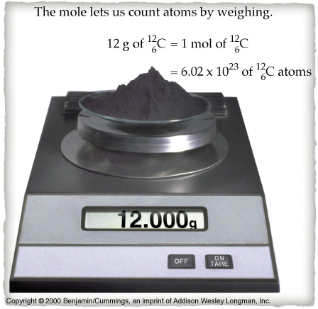
The Mole’s Purpose

Slide 21
Let’s practice some conversions
How many atoms are in 1 mol of Sodium-23?
How many atoms are in 1 mol of Gold-203?
How many molecules are in 1 mol of water?

Slide 22
Let’s try some more
How many mols are in 6.02 * 10 ^ 23 atom of Chlorine-35?
How many mols are in 6.02 * 10 ^ 23 atom of Bromine-81?
How many mols are in 3.01 * 10 ^ 23 molecules of carbon dioxide?

Slide 23
Molar mass
What are the units of molar mass? Remember it’s the number of grams in 1 mol
What is the molar mass of Carbon?
What is the molar mass of Cobalt?
What is the molar mass of Calcium?

Slide 24
Calculate molecular weights
To calculate molecular weights (or molar masses of compounds or molecules)
Simply add up their individual molar masses based on the their chemical formula
For example
H20 has 2 hydrogens and 1 oxygen
hydrogen is 1.01 g/mol and oxygen is 16.0 g/mol therefore water is 18.02 g/mol

Slide 25
Calculate molecular weights
Of carbon dioxide…
Of CH4 (methane)….
Of Oxygen gas….
Of CuSO4….

Slide 26
A different example

Slide 27
Now let’s go from mols to grams
Using molar masses…..
How many grams are in 5 mol of sodium

Slide 28
Moles to Liters
STP (0 degrees celsius and 1 atmosphere)
At STP 1 mole of any gas occupies 22.4 liters of volume
This is by far the most straight forward conversion we will do…
This is the last branch of the chart I prescribed earlier in this unit! (let’s take a look on more time)

Slide 29
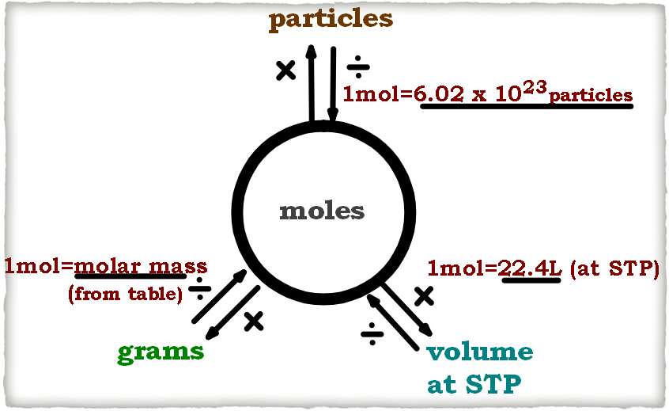

Slide 30
STP
Standard temperature and pressure
0 degrees Celsius
1 atm
These are standardized conditions by which values are compared

Slide 31
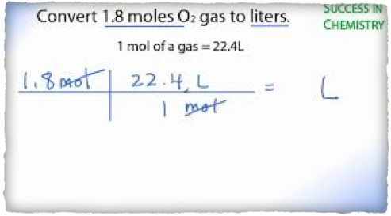
Example Problem
How many liters in 1.8 moles of gas at STP?

Slide 32
Practice Problems
How many liters does 4 mols of Chlorine gas occupy at STP?
How many liters are in 15 grams of oxygen at STP.

Slide 33
Percent Composition
Percent composition is what we will look at in terms of very useful analytical chemistry techniques
It is the beginning of an applied usage of moles
Uses:
Verifying composition of molecules!
Determining the purity of certain pounds

Slide 34
Percent Composition
Definition: percent composition is used to determine the amount, by mass, of each element present in a chemical compound

Slide 35
How do we calculate percentages?

Slide 36
Calculating percentages
Percent through roots means…
per 100
Part/Total x 100%

Slide 37
Percent composition analogy
Let’s say you weigh 145 pounds….
and you are 30 pounds of carbon
Then to find what percent you are carbon…
What do we do?

Slide 38
Percent Composition by Mass (mass fraction)
To calculate percent composition (by mass) of compounds we will take the same steps using molar masses
To find the percent composition of each element in the compound…
1. Find the molecular weight of the compound
2. Divide the mass of the individual elements by the molecular weight and multiply by 100%

Slide 39
Sample Calculation

Slide 40
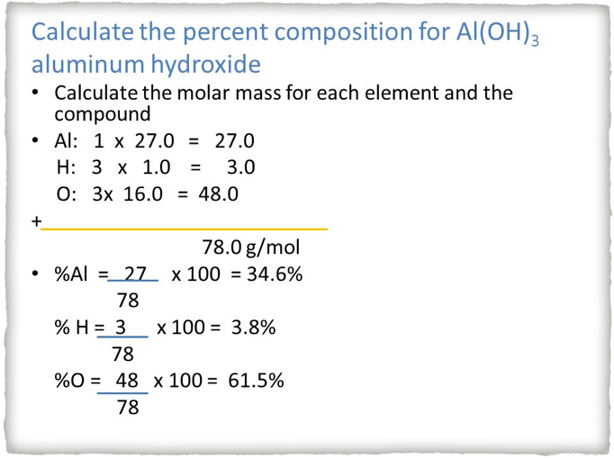

Slide 41
Using percent compositions
Practice:
Find the percent composition of water in Calcium Chloride Dihydrate
Find the percent composition of water in Sodium Carbonate Decahydrate

Slide 42
Important Uses of Percent Composition
Precious metals/diamonds
Medicine
Food products
Cleaning products

Slide 43
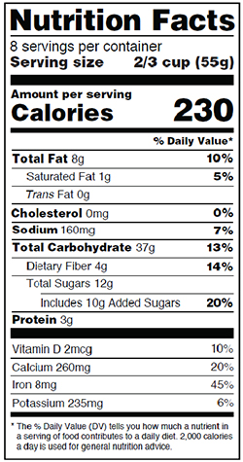
Nutrition Labels

Slide 44
Practice
What is the percent by mass of hydrogen and oxygen in water?
Calculate MW of water.
Divide the MW by individual molar masses.
What is the percent by mass of copper of in copper (II) sulfate?

Slide 45
Percent Error Review
In an experiment, Kelly calculates on her elemental analyzer that percent composition of copper in copper (II) sulfate is 25%. What is her percent error based on your calculations of the percent of copper by mass in the compound?
Find the theoretical percent composition and then compare it to the measured value

Slide 46
Empirical Formulas
Empirical formulas are the simplest way a molecule or compound in whole number integer ration can be expressed
For example the empirical formula of C2H8 would be CH4
If a compound is already in its simplest form, then its empirical formula is the molecular formula
For example, H20 is already simplified

Slide 47
Steps in Calculating Empirical Formulas
Interpret the percent composition data as grams
Convert each to moles by dividing by molecular weight
Divide each mol calculation through by the lowest number of moles
Round each value to the nearest whole number, if it is near 0.5, multiply through by 2

Slide 48
Using Empirical Formulas to Calculate Formulas of Hydrates
Using the percent value of water, determine the percent by mass of the compound
Interpret percentages as mass amounts
Convert each amount to moles
Divide through by the lowest value
Round each calculation to the nearest integer

Slide 49
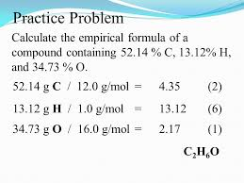
Sample Calculation

Slide 50
Practice problem
What is the formula and name of a hydrate that is 85.3% barium chloride and 14.7% water?

Slide 51
Practice problem
Vanadium oxide is used as an industrial catalyst. The percent composition of this oxide is 56.0% vanadium and 44.0% oxygen
Determine empirical formula

Slide 52
Molecular Formulas from Empirical Data
Empirical data is correct in that it identifies the proper ratio of elements in a compound however….
Some empirical formulas due not represent the true number of moles in a compound
Molecular formula species the actual number of atoms of each element in one molecule of an element

Slide 53
Molecular formula from empirical data
First calculate the empirical formula
Molecular formula = (empirical formula) x n
Find n by dividing the mass of the empirical formula by the mass of the molecular formula
Multiply the subscripts through by the whole number integer you found
Hint: it may not be exact…round to what ever is closest

Slide 54
Practice problem

Slide 55
Practice problem
Analysis of a compound containing chlorine and lead reveals that the compound is 59.37% lead. The molar mass of the compound is 349.0 g/mol.
What is the empirical formula for the chloride compound?
What is the molecular formula?

Slide 56
Hydrates
Hydrates are compounds that have a specific number of water molecules attached to its atoms
In reality a lot of compounds are hydrophilic (like water)
Na2CO3 * 10 H20
This is named sodium carbonate decahydrate

Slide 57
Analytical Chemistry
studies and uses instruments and methods used to separate, identify, and quantify matter
In the modern era, this plays a part in almost every aspect of industry
Testing purity of medicine, composition of food additives, and many others

Slide 58
Analyzing Hydrates
To analyze a hydrate, I must drive off the water (separation)
Due to differences in boiling points and ability to break the intermolecular forces between the compound and attached waters with heat
Determining the percentage of water in a hydrate and is chemical formula is a good example of analytical chemistry

Slide 59
Uses of Hydrates
Desiccant!
Or…
Maybe you don’t want your compound to absorb water in which case, you would perform a similar test to make sure that it is remaining dry (anhydrous)

